Slide 1
Computer Systems
Grade 12 CAT

Slide 2
Types of Computer Systems
Personal
SOHO
Mobile
Power users
Data vs Information
Convergence
Bibliography

Slide 3
Personal
Usually called a PC
Found the home or small business environment
Definition:
A PC can be defined as a reasonably priced computer for a single user that is driven by software that is fairly simple to use

Slide 4
History of the PC
IBM introduced a model that they called a “PC”
Usually used within an office context
Apple introduced a model that they called the Apple Mac
Usually used by the design industry
Essentially both can be regarded as a PC in the modern sense.

Slide 5
Essential Components
Microprocessors
Keyboard
Monitor
Mouse
Extension ports to house
Speakers
Printers
etc.

Slide 6
SOHO
Small Office Home Office
Also known as A virtual office or
A single location firm
It usually employees between 0 and 10 people.
The owner can outsource his firm to larger businesses who need his expertise thus economising on space, equipment and staff.

Slide 7
SOHO equipment
A good fast computer system
software that is applicable to his job,
a good printer,
excellent internet hardware, software and connection,
headphones and/or speakers as well as a compatible handset for internet calls

Slide 8
Mobile computing features
Continuous wireless connection – depending on coverage
Usually Bluetooth and WiFi enabled
Portable equipment due to size
Size varies from tiny to almost bulky
Abilities and applications vary according to model

Slide 9
Mobile devices
Laptops
Notebooks
Netbooks
Smartphones
Phablet
Tablet
Wearable computers
Carputer
Return to beginning

Slide 10
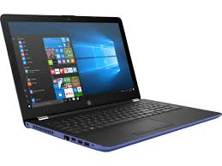
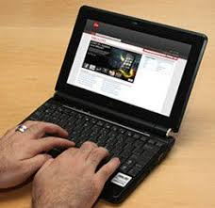
Types of Laptops
Notebooks
Recently the two terms Laptops and Notebooks have come to mean the same thing.
It has the same functionality as a desk top computer.
Netbooks
Smaller, slower, less powerful
Does not have a CD/DVD drive

Slide 11
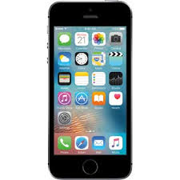
Smartphones
Usually has a touch screen
Input and
Output
Reduced functionality compared to a computer
Internet connection via WiFi or service provider
It can run inbuilt or downloaded apps

Slide 12
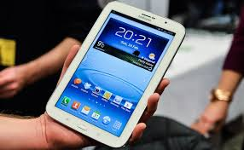
Phablet
Similar functionality to a smartphone BUT
It has a larger screen
It is bigger
It has better capabilities
It straddles the gap between a Smartphone and a Tablet

Slide 13
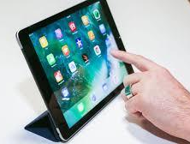
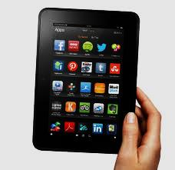
Tablet
Larger than phablets
More powerful than phablets
More versatile than phablets
Examples:
Apple iPad
Kindle Fire
iPad
Kindle
Fire

Slide 14
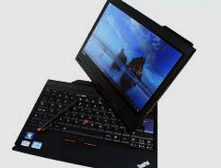
Convertible Tablet
Can take an external keyboard
Touch screen can
Recognise handwriting
Be operated by a finger or stylus
Has an onscreen keyboard

Slide 15
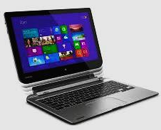
Hybrid Tablet
Resemble a netbook
The keyboard is detachable.
When detached the monitor is a fully functional tablet

Slide 16
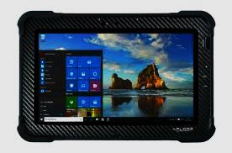
Rugged tablets
Have a thick protective shell
Shell protects the tablet from extreme use
Very popular when the work environment has
A rough terrain
Harsh weather conditions
Useful when more delicate equipment would be damaged by external actions.

Slide 17
Wearable computers

Slide 18
Wearable functions
At the moment the most popular form of wearable computers is a type of watch. However the sky is the limit as far as wearable computers are concerned. This technology is in its infancy and designers are limited only by their imagination. Cost is an important factor as well. Monitoring health is currently one of the prime functions.
https://www.slideshare.net/niteshnayal/ppt-wearable-computer
https://www.slideshare.net/fbviralmehta/wearable-computer-12242345

Slide 19
Watches
These can
Alert you when you receive an SMS, e-mail etc.
Display the above
Keep track of your heart rate
Keep track of how many steps you take
Be a media player
Send text messages

Slide 20
Smart Glasses
These will change how you view the world.
A pair of these glasses have the capabilities of a phablet or tablet
They have a virtual display.
Virtually every function of a smart phone is available to these glasses.
https://www.youtube.com/watch?v=iaUOYa6SVsk

Slide 21
A quick look at Smart Glass
A Day Made Of Glass
https://www.youtube.com/watch?v=6Cf7IL_eZ38
A Day Made Of Glass 2
https://www.youtube.com/watch?v=jZkHpNnXLB0
A Day Made Of Glass Unpacked
https://www.youtube.com/watch?v=X-GXO_urMow

Slide 22
Carputer
These are computers that are used inside a car.
Examples:
Diagnostic computers
GPS
Media players

Slide 23
Power Users
Experienced computer user
Advanced skills in the software they are using
They need the best and faster computer available

Slide 24
Examples of Power Users
Graphic designers
Video editors
Audio producers
Professional gamers

Slide 25
Data vs Information
Data is raw
Once it has been analysed and used in reports it is considered to be InformTION
An information Manager (IM) takes care of it, manipulates it and steers it to the department that can use it

Slide 26
IM duties
Plan how to deal with the data
Organise it in a way that it can be processed
Structure the software to deal with it
Process the data
Control what happens to it once it becomes information
Evaluate the results and finally
Report the results to the relevant department

Slide 27
Reasons for using computers
saving paper, time, labour
communication costs
efficiency
accuracy
reliability
effect on time and distance
global communication including social networks and web tools such as blogs, wikis, etc.

Slide 28
Convergence
If things converge they are moving to a common point
In IT research has led to items sharing switches
This minimises hardware and wiring
It is more efficient and cost effective for the firm

Slide 29
Bibliography
www.wikipedia.com
www.whatis.techtarget.com/
www.webopedia.com
www.techterms.com
www.pcmag.com
www.howstuffworks.com
www.pensitdown.com

